Slide 1

Home assignment

Slide 2
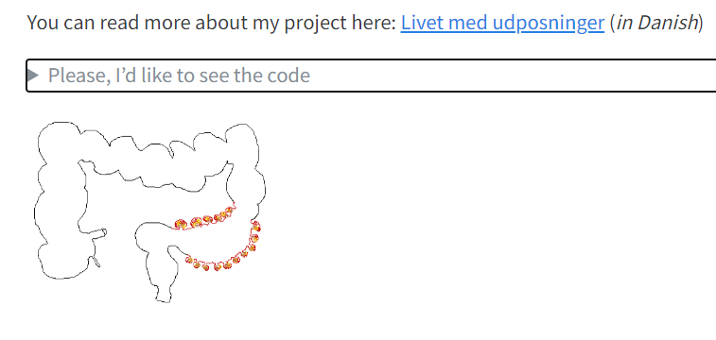
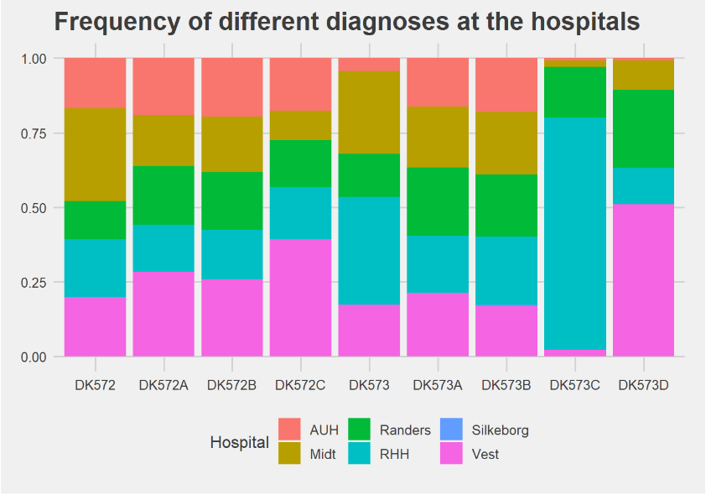
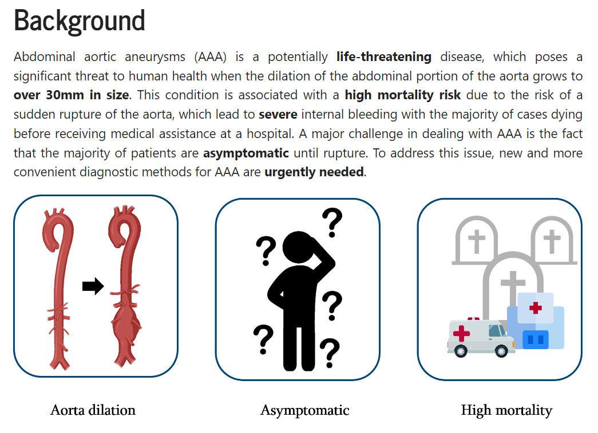
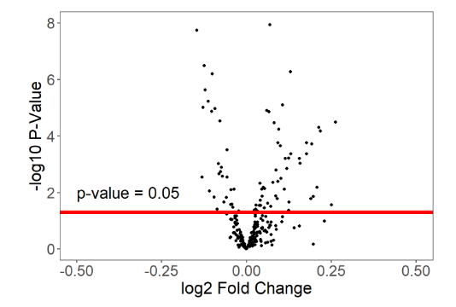
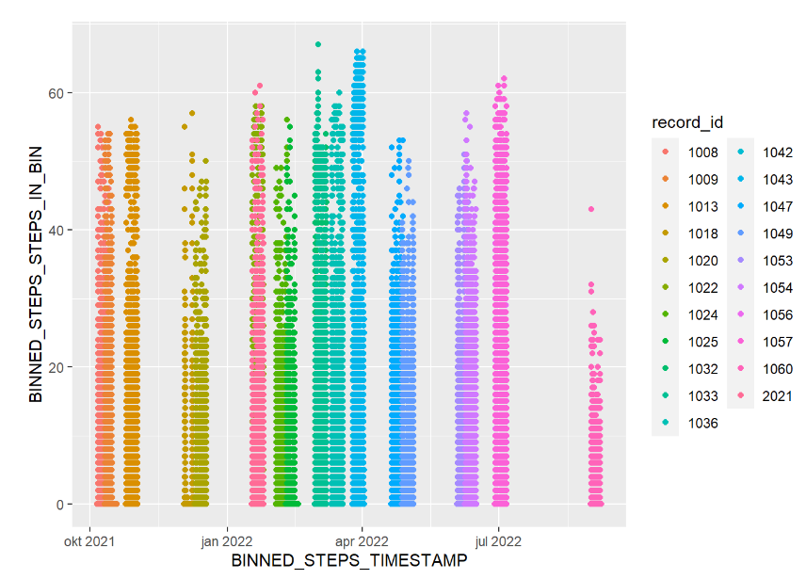
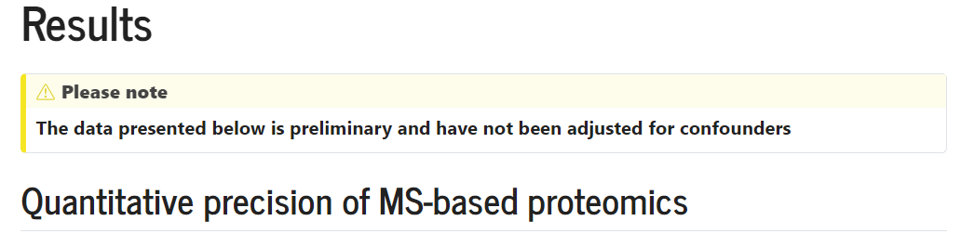

Slide 3

here()
Short youtube video: https://www.youtube.com/watch?v=RSXXYxCz630
Short Blog: https://www.tidyverse.org/blog/2017/12/workflow-vs-script/

Slide 4
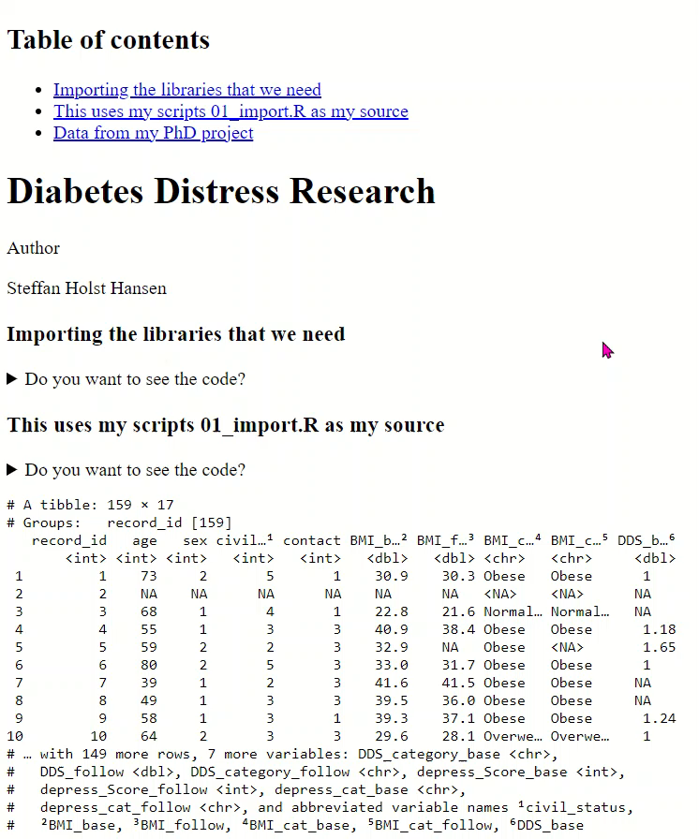
embed-resources: true

Slide 5
Tidy data structure

